Slide 1







lightform.org.uk
MatFlow and its application to TiFUN
Adam Plowman, João Quinta da Fonseca, Pratheek Shanthraj
TiFUN Progress Meeting, 07/04/2022

Slide 2


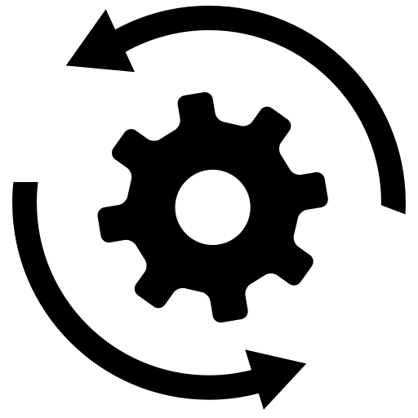
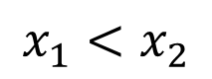
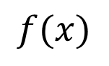
MatFlow: context
What can we do with data to maximise its value?
So what should data look like?
To enable these scenarios, data should be:
associated with explicit metadata
linked to source and derived data
accessible to humans and machines
transparent
📊
$$f(x)$$
Visualise
Analyse
$$x_{1}<x_{2}$$
Share/reuse
Compare
Explicit metadata example: orientations
Rotation representation
Euler angles: proper/improper, ordering, deg/rad
Quaternions: scalar-vector/vector-scalar
Alignment of spatial reference frame
Alignment of unit cell
Active/passive rotations
P value ±1
🖥↔🖥
Reproduce
results
Automate decisions/
processing

Slide 3
How to make data look like that?
MatFlow: context
Use cases limited
Data attributes
Adopt a framework that implements general concepts:
Workflow: series of tasks
Task: processing of well-defined parameters
Parameters: data + metadata
partial metadata
isolated
proprietary
ambiguous
Use cases unlimited
Data and processing encapsulation:
Data attributes
full metadata
linked
accessible
transparent
Task 1
Task 2
Task 3
Notes:
MatFlow makes it easier to generate data with good attributes!

Slide 4
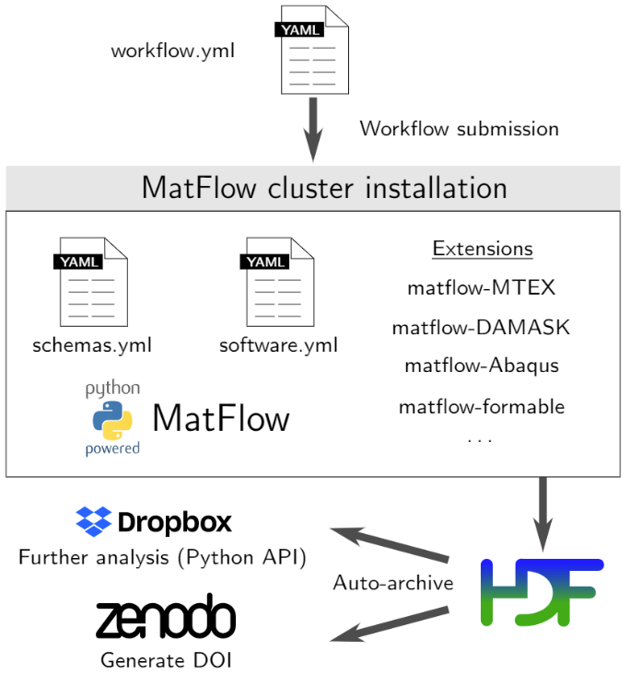
What is MatFlow?
MatFlow
Open-source, open-format Python Code for computational materials science
Making reproducibility and transparency require less effort
Connecting disparate software via extensions
Making comparisons easier
Allows a group to “bank” their knowledge

Slide 5
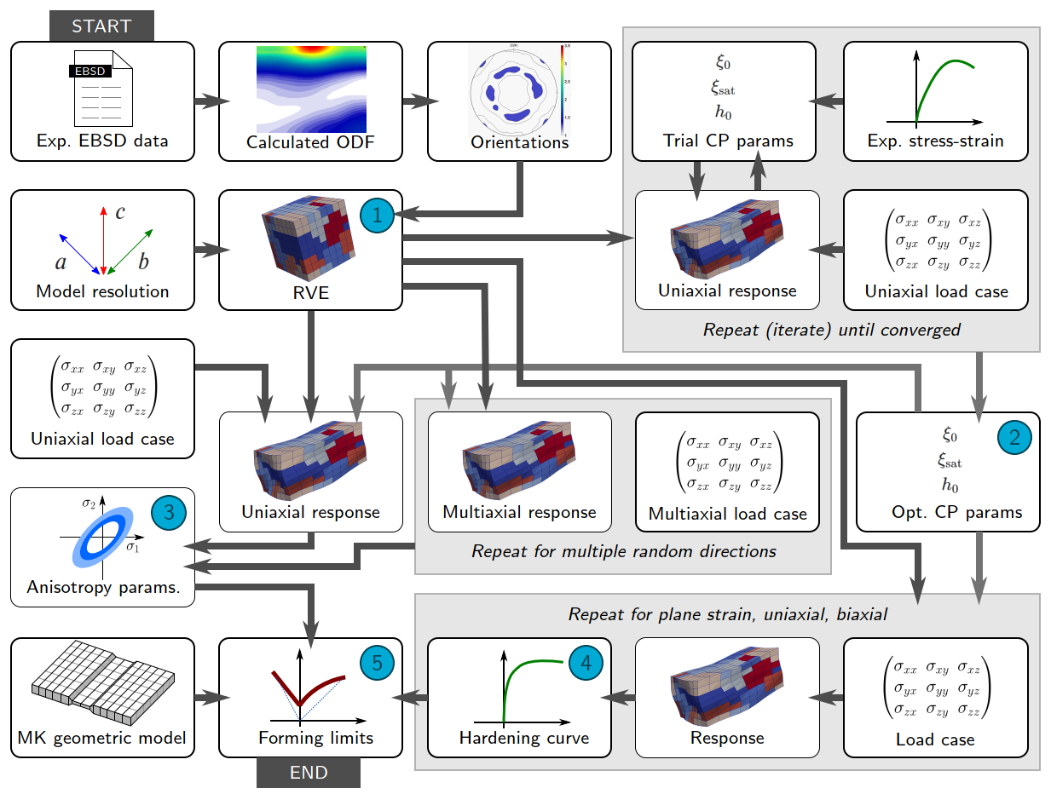
From elsewhere in LightForm…
Computational formability predictions
Generate representative RVE from EBSD data
Fit single-crystal parameters from tensile tests
Fit anisotropy parameters from crystal plasticity
Simulate hardening curves for different loading
Predict forming limits
Reusable components can be used elsewhere… like in TiFUN
Notes:
Re-usable tasks make computational work/prototyping faster to get up and running (esp. for new students)

Slide 6
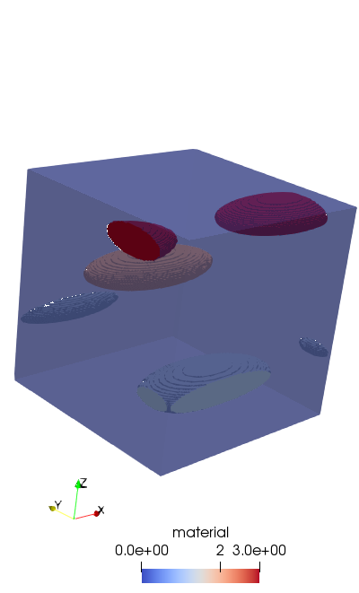
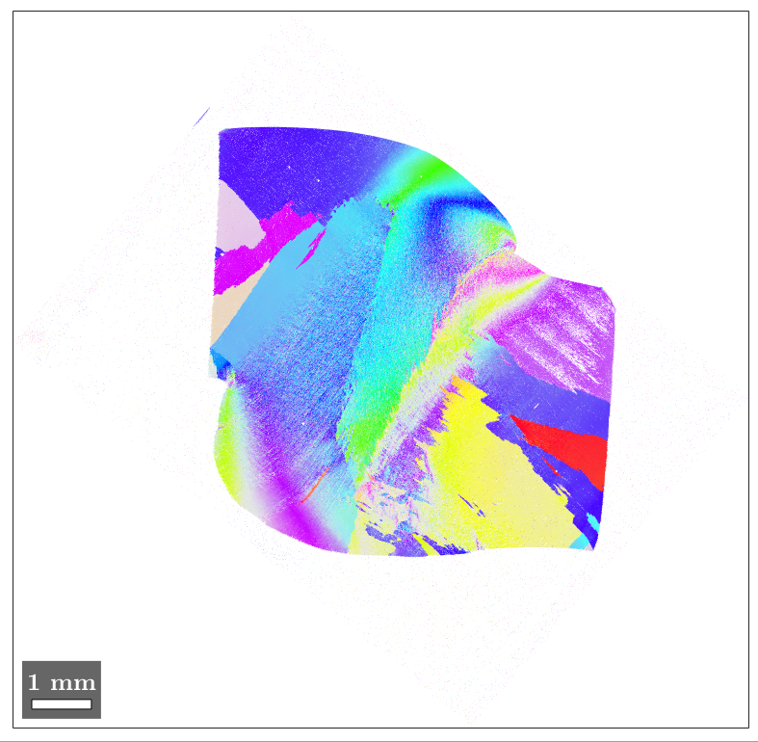
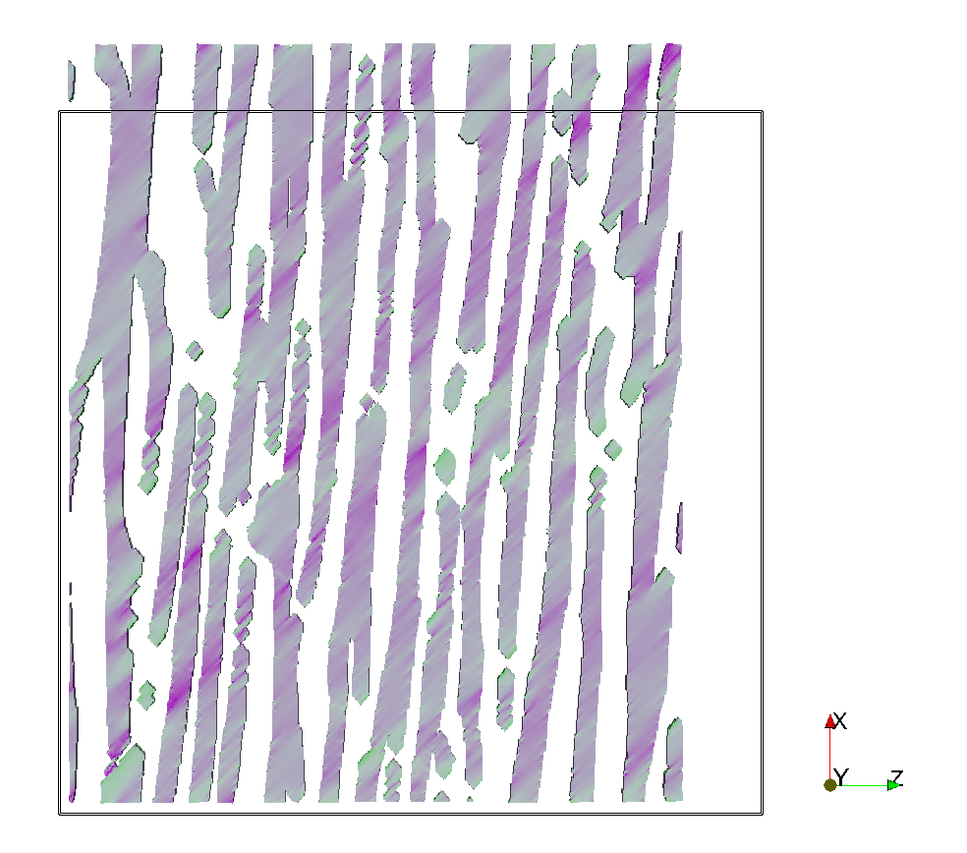
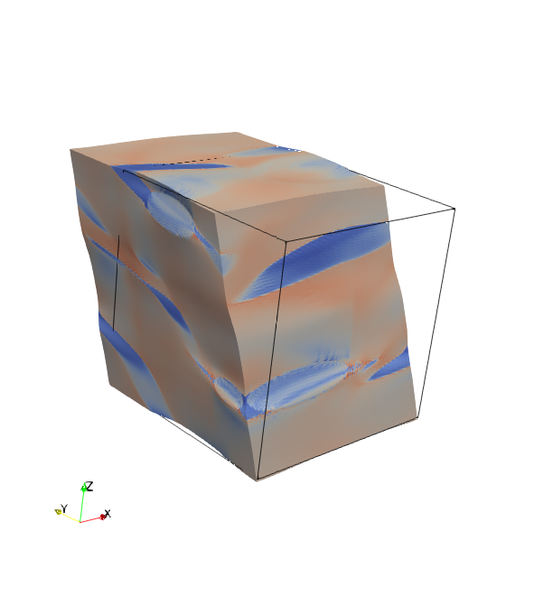


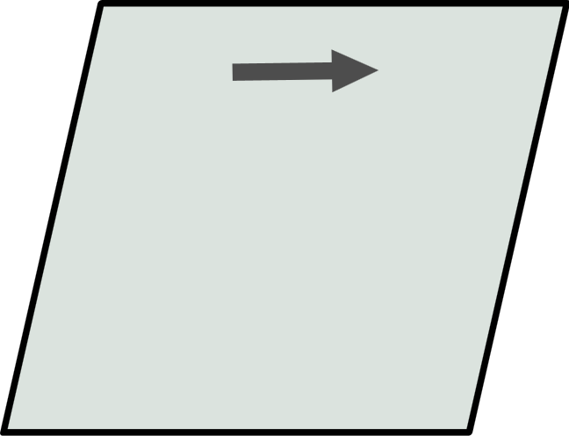
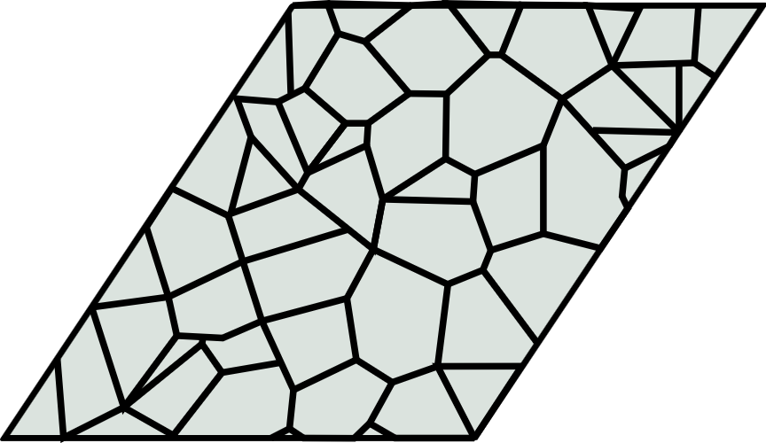
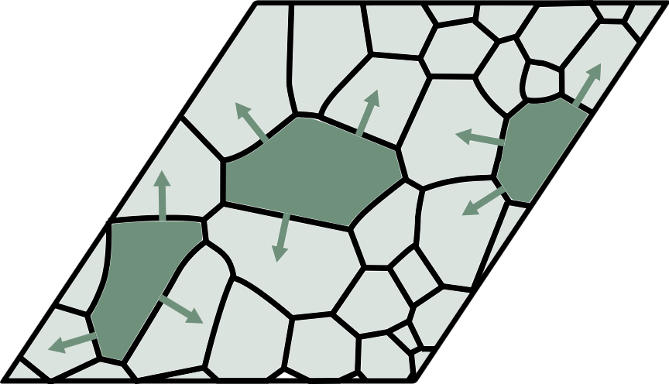
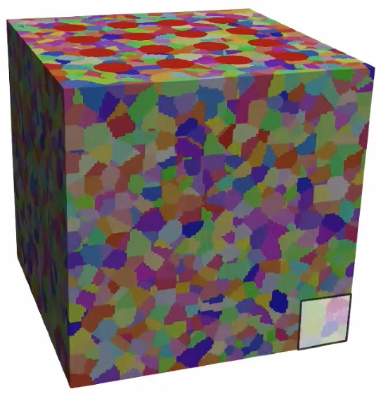
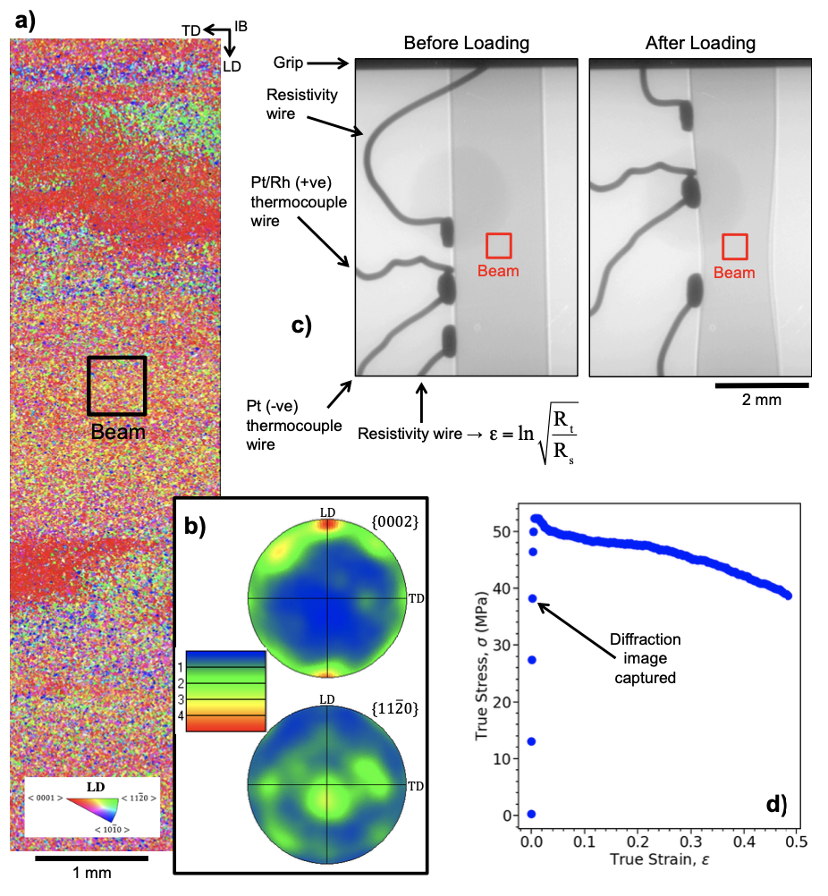
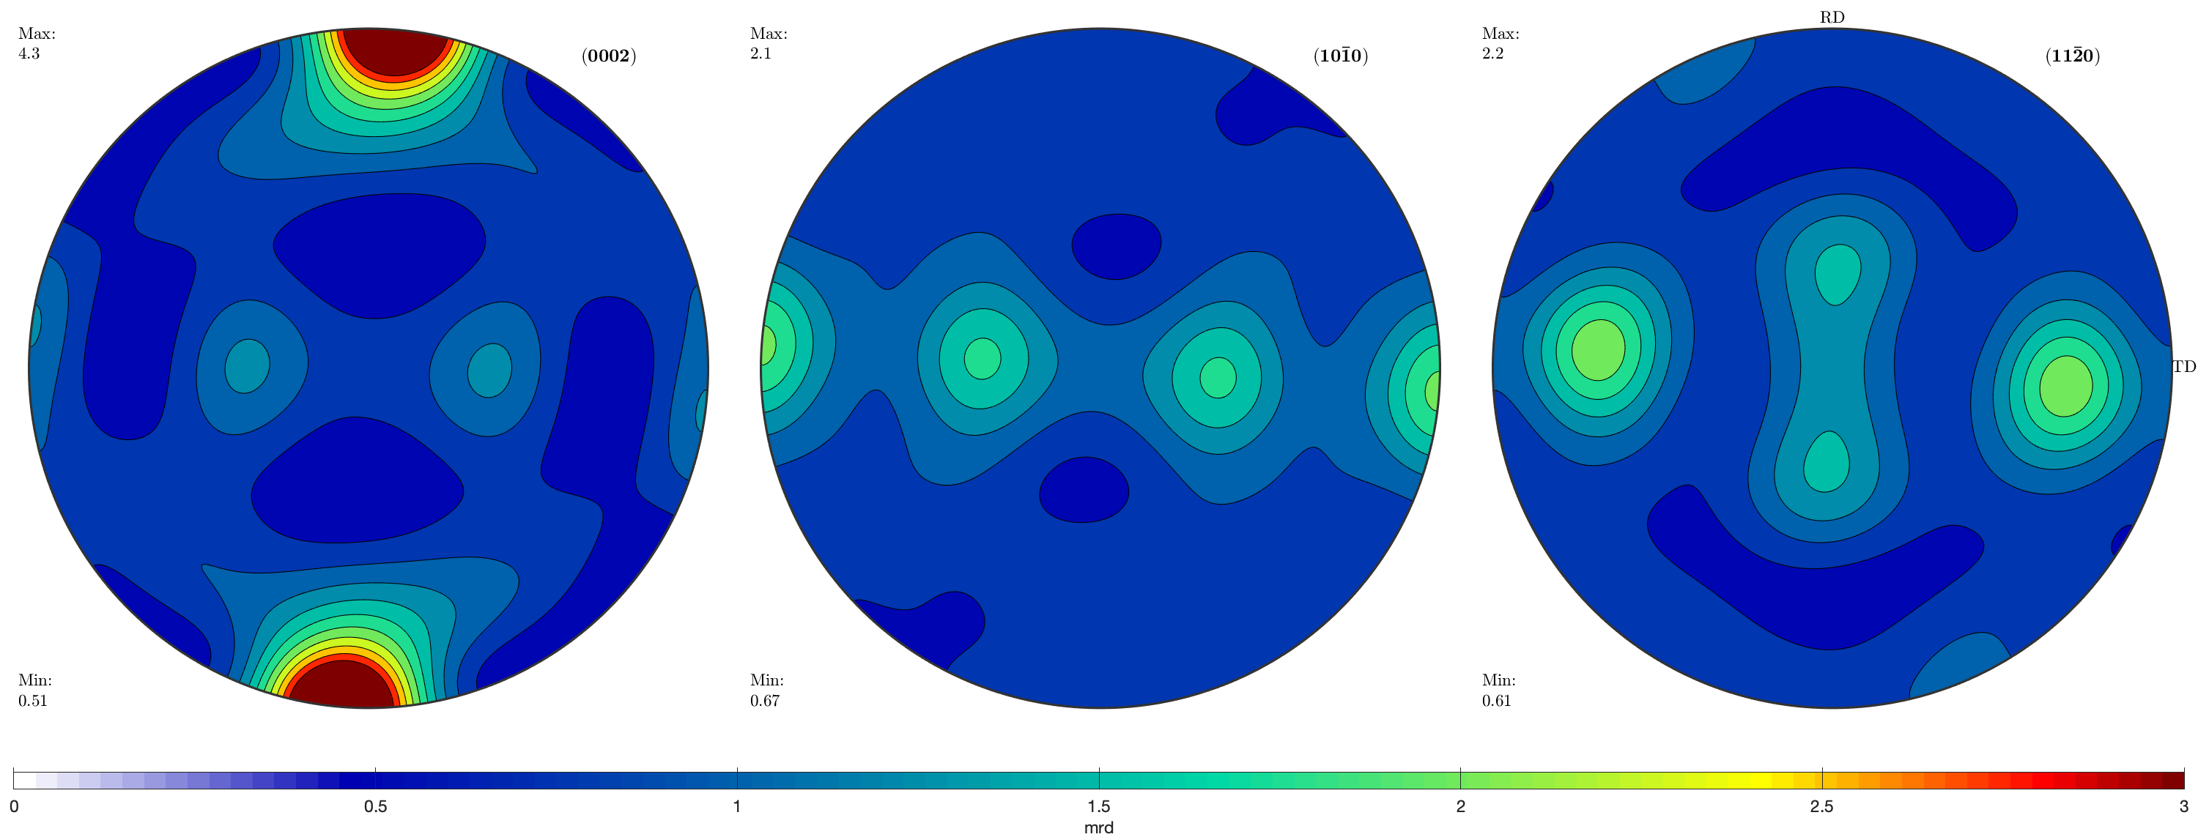
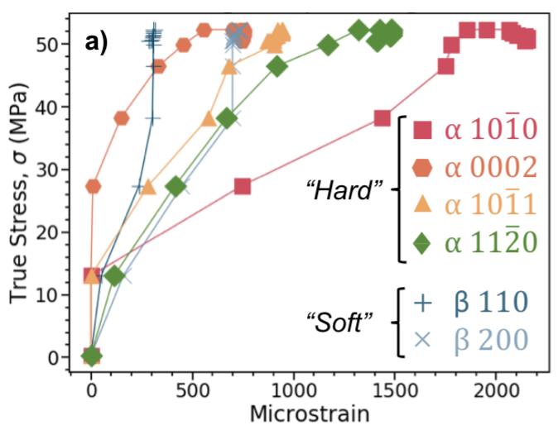
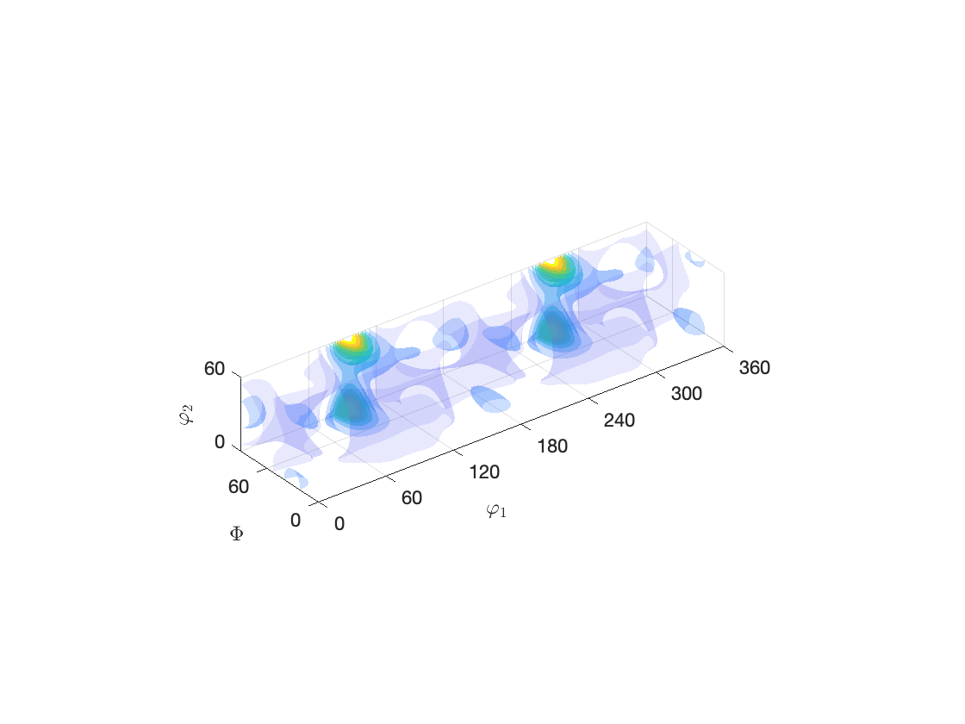
TiFUN workflows
Our toolkit for microstructural development in dual-phase Ti hot rolling
Well-trodden
Sampling experimental texture (MTEX)
Simple crystal plasticity simulations (DAMASK)
Iterative “multi-pass” rolling simulations (DAMASK)
Pole figure generation (MTEX)
Synthetic microstructures
Real microstructures
CIPHER
Under dev. (various stages)
Generation of synthetic dual-phase material
Grain segmentation post-processing via MTEX
Phase-field simulations via CIPHER
Simulation of real microstructures
Single-crystal parameter validation from XRD data
Coupled crystal-plasticity/phase-field simulations
Notes:
Integration of existing scripts/python code etc can happen gradually, as our methodologies solidify.

